Slide 1


Introduction to Quantum Chemistry
——Linear Algebra 2
张冀鹏
北京师范大学化学学院
2026. 7. 13

Slide 2

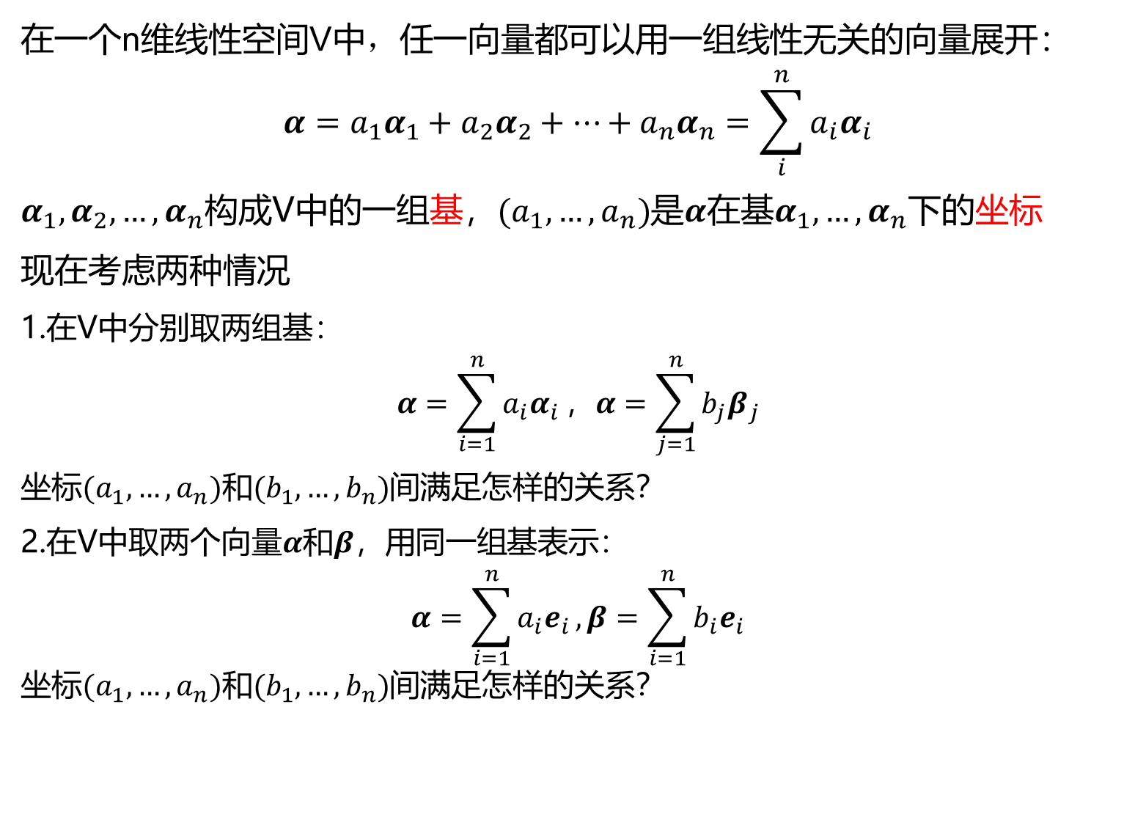
Review: Linear space
在一个n维线性空间V中，任一向量都可以用一组线性无关的向量展开：
$$α=a_{1}α_{1}+a_{2}α_{2}+⋯+a_{n}α_{n}=\sum_{i}^{n}{a_{i}α_{i}}$$
$α_{1}, α_{2}, …,α_{n}$构成V中的一组基，$(a_{1}, …,a_{n})$是$α$在基$α_{1}, …,α_{n}$下的坐标
现在考虑两种情况
1.在V中分别取两组基：
$$α=\sum_{i=1}^{n}{a_{i}α_{i}}，α=\sum_{j=1}^{n}{b_{j}β_{j}}$$
坐标$(a_{1}, …,a_{n})$和$(b_{1}, …,b_{n})$间满足怎样的关系？
2.在V中取两个向量$α$和$β$，用同一组基表示：
$$α=\sum_{i=1}^{n}{a_{i}e_{i}}, β=\sum_{i=1}^{n}{b_{i}e_{i}}$$
坐标$(a_{1}, …,a_{n})$和$(b_{1}, …,b_{n})$间满足怎样的关系？

Slide 3

Review: Mapping
给定两个非空集合$A$和$B$，如果存在对应法则$f$，使得$∀x∈A$，都存在唯一的$y∈B$与之对应，则称$f$是从$A$到$B$的一个映射。
简记为$f:A→B$
$x↦f(x)$
映射中的几个要素：
定义域：$A$
陪域：$B$
值域：$f\left(A\right)∈B$
对应关系：$f$

Slide 4
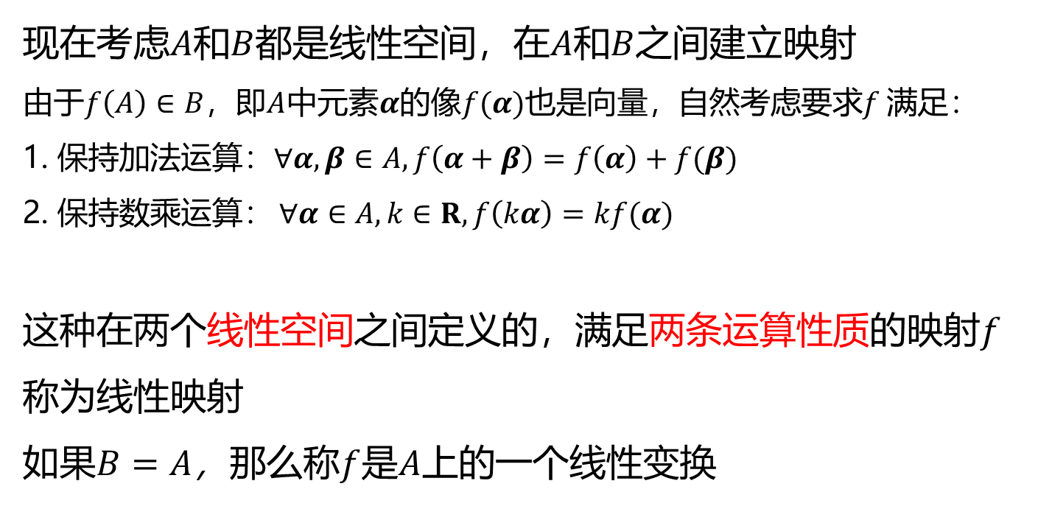
Linear transformation
现在考虑$A$和$B$都是线性空间，在$A$和$B$之间建立映射
由于$f\left(A\right)∈B$，即$A$中元素$α$的像$f(α)$也是向量，自然考虑要求$f$满足：
1. 保持加法运算：$∀α,β∈A, f\left(α+β\right)=f\left(α\right)+f(β)$
2. 保持数乘运算： $∀α∈A, k∈R, f\left(kα\right)=kf(α)$
这种在两个线性空间之间定义的，满足两条运算性质的映射$f$称为线性映射
如果$B=A$，那么称$f$是$A$上的一个线性变换

Slide 5
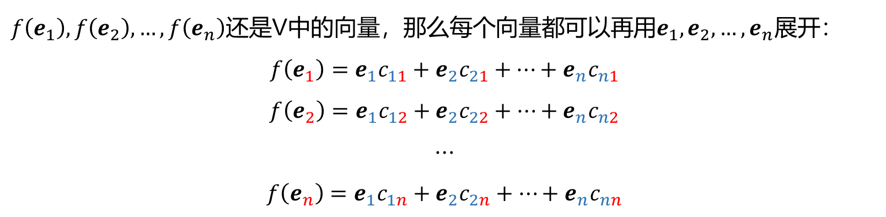
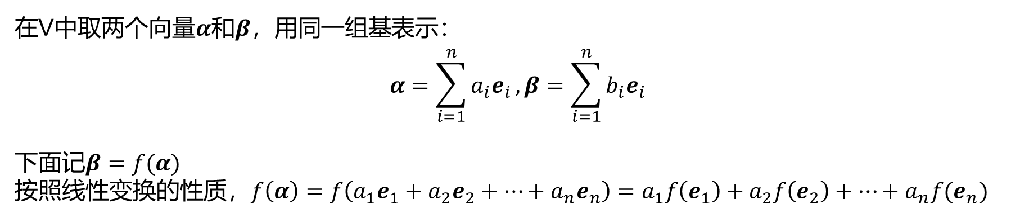
Linear transformation
主动变换
在V中取两个向量$α$和$β$，用同一组基表示：
$$α=\sum_{i=1}^{n}{a_{i}e_{i}}, β=\sum_{i=1}^{n}{b_{i}e_{i}}$$
下面记$β=f(α)$
按照线性变换的性质，$f\left(α\right)=f\left(a_{1}e_{1}+a_{2}e_{2}+⋯+a_{n}e_{n}\right)=a_{1}f\left(e_{1}\right)+a_{2}f\left(e_{2}\right)+⋯+a_{n}f(e_{n})$
$f\left(e_{1}\right),f\left(e_{2}\right),…,f\left(e_{n}\right)$还是V中的向量，那么每个向量都可以再用$e_{1}, e_{2}, …,e_{n}$展开：
$$f\left(e_{1}\right)={e_{1}c}_{11}+{e_{2}c}_{21}+⋯+{e_{n}c}_{n1}$$
$$f\left(e_{2}\right)={e_{1}c}_{12}+{e_{2}c}_{22}+⋯+{e_{n}c}_{n2}$$
$$⋯$$
$$f\left(e_{n}\right)={e_{1}c}_{1n}+{e_{2}c}_{2n}+⋯+{e_{n}c}_{nn}$$

Slide 6

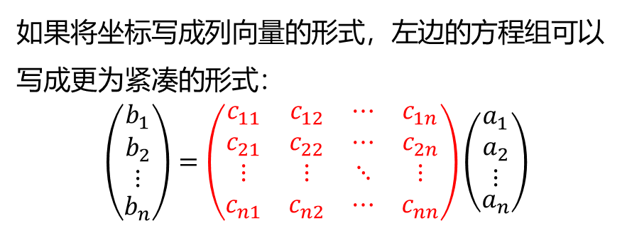
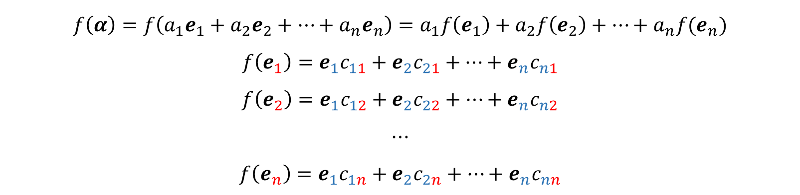
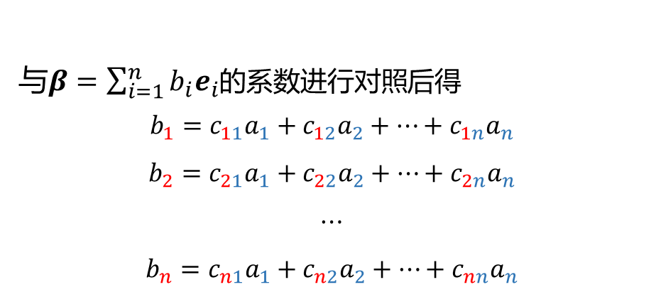
Linear transformation
主动变换
$$f\left(α\right)=f\left(a_{1}e_{1}+a_{2}e_{2}+⋯+a_{n}e_{n}\right)=a_{1}f\left(e_{1}\right)+a_{2}f\left(e_{2}\right)+⋯+a_{n}f(e_{n})$$
$$f\left(e_{1}\right)={e_{1}c}_{11}+{e_{2}c}_{21}+⋯+{e_{n}c}_{n1}$$
$$f\left(e_{2}\right)={e_{1}c}_{12}+{e_{2}c}_{22}+⋯+{e_{n}c}_{n2}$$
$$⋯$$
$$f\left(e_{n}\right)={e_{1}c}_{1n}+{e_{2}c}_{2n}+⋯+{e_{n}c}_{nn}$$
与$β=\sum_{i=1}^{n}{b_{i}e_{i}}$的系数进行对照后得
$$b_{1}=c_{11}a_{1}+c_{12}a_{2}+⋯+c_{1n}a_{n}$$
$$b_{2}=c_{21}a_{1}+c_{22}a_{2}+⋯+c_{2n}a_{n}$$
$$⋯$$
$$b_{n}=c_{n1}a_{1}+c_{n2}a_{2}+⋯+c_{nn}a_{n}$$
如果将坐标写成列向量的形式，左边的方程组可以写成更为紧凑的形式：
$$\left(\begin{aligned}\begin{matrix}b_{1} \\ b_{2} \\ ⋮\end{matrix} \\ b_{n}\end{aligned}\right)=\left(\begin{matrix}c_{11} & c_{12} & ⋯ & c_{1n} \\ c_{21} & c_{22} & ⋯ & c_{2n} \\ ⋮ & ⋮ & ⋱ & ⋮ \\ c_{n1} & c_{n2} & ⋯ & c_{nn}\end{matrix}\right)\left(\begin{aligned}\begin{matrix}a_{1} \\ a_{2} \\ ⋮\end{matrix} \\ a_{n}\end{aligned}\right)$$
这样的一个列表称为$n×n$矩阵

Slide 7
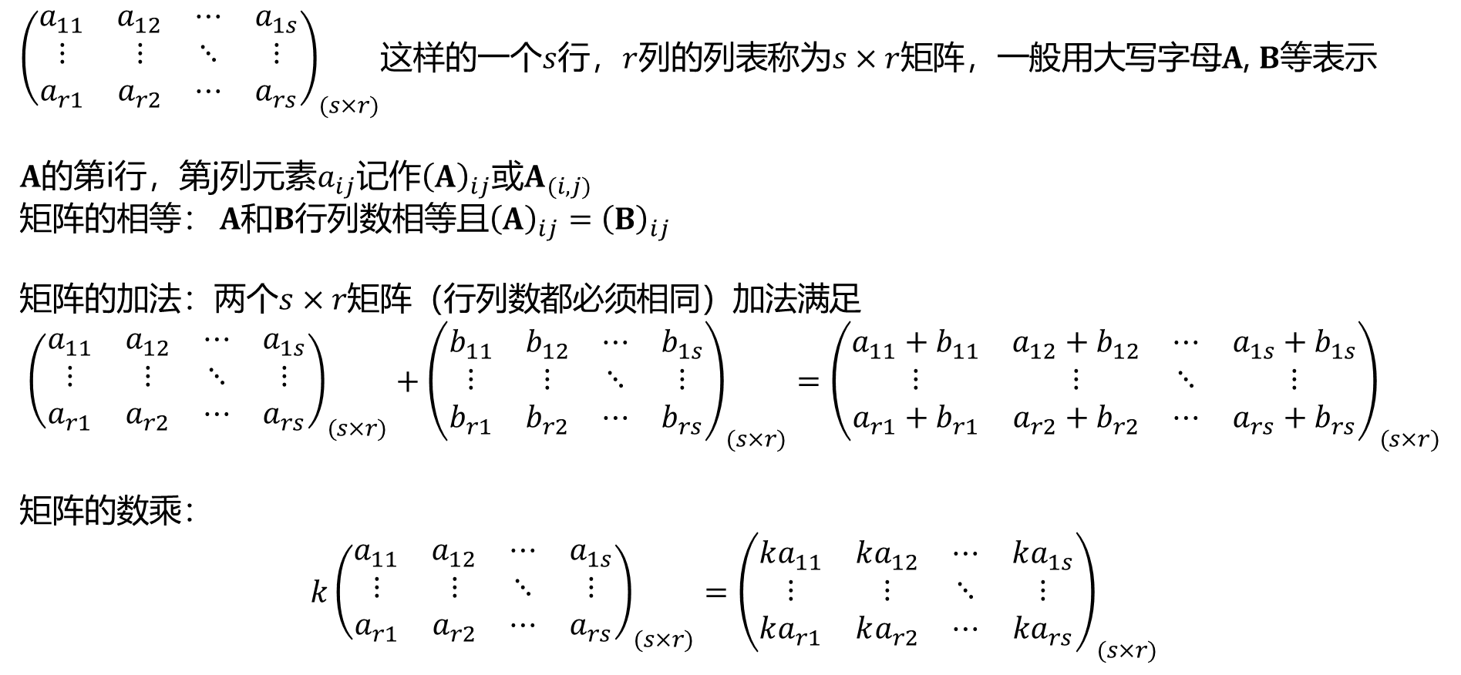
Matrix
在继续讨论线性变换之前，先介绍矩阵和矩阵相关运算
${\left(\begin{matrix}a_{11} & a_{12} & ⋯ & a_{1s} \\ ⋮ & ⋮ & ⋱ & ⋮ \\ a_{r1} & a_{r2} & ⋯ & a_{rs}\end{matrix}\right)}_{(s×r)}$这样的一个$s$行，$r$列的列表称为$s×r$矩阵，一般用大写字母$A$, $B$等表示
$A$的第i行，第j列元素$a_{ij}$记作${\left(A\right)}_{ij}$或$A_{(i,j)}$
矩阵的相等： $A$和$B$行列数相等且${\left(A\right)}_{ij}={\left(B\right)}_{ij}$
矩阵的加法：两个$s×r$矩阵（行列数都必须相同）加法满足
$${\left(\begin{matrix}a_{11} & a_{12} & ⋯ & a_{1s} \\ ⋮ & ⋮ & ⋱ & ⋮ \\ a_{r1} & a_{r2} & ⋯ & a_{rs}\end{matrix}\right)}_{(s×r)}+{\left(\begin{matrix}b_{11} & b_{12} & ⋯ & b_{1s} \\ ⋮ & ⋮ & ⋱ & ⋮ \\ b_{r1} & b_{r2} & ⋯ & b_{rs}\end{matrix}\right)}_{(s×r)}={\left(\begin{matrix}a_{11}+b_{11} & a_{12}+b_{12} & ⋯ & a_{1s}+b_{1s} \\ ⋮ & ⋮ & ⋱ & ⋮ \\ a_{r1}+b_{r1} & a_{r2}+b_{r2} & ⋯ & a_{rs}+b_{rs}\end{matrix}\right)}_{(s×r)}$$
矩阵的数乘：
$$k{\left(\begin{matrix}a_{11} & a_{12} & ⋯ & a_{1s} \\ ⋮ & ⋮ & ⋱ & ⋮ \\ a_{r1} & a_{r2} & ⋯ & a_{rs}\end{matrix}\right)}_{(s×r)}={\left(\begin{matrix}ka_{11} & ka_{12} & ⋯ & ka_{1s} \\ ⋮ & ⋮ & ⋱ & ⋮ \\ ka_{r1} & ka_{r2} & ⋯ & {ka}_{rs}\end{matrix}\right)}_{(s×r)}$$

Slide 8
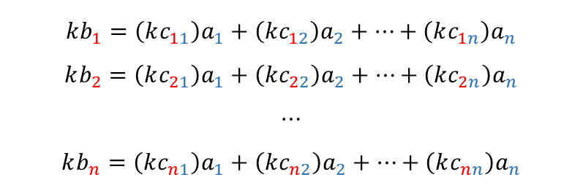
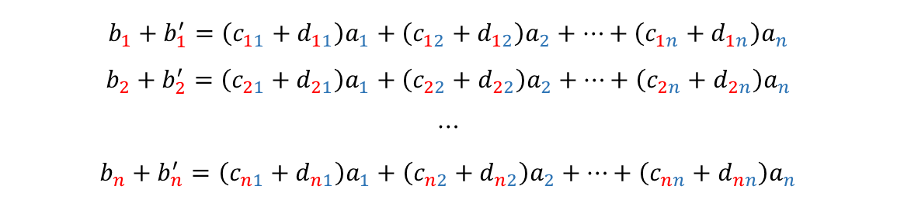
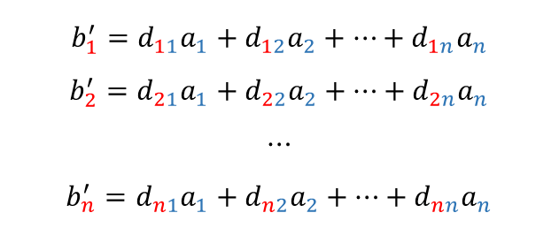
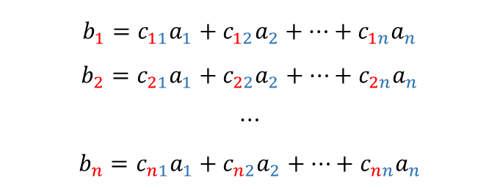
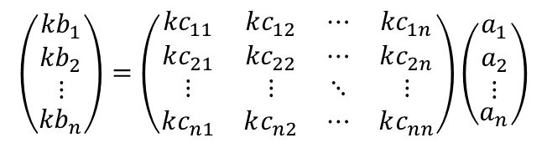
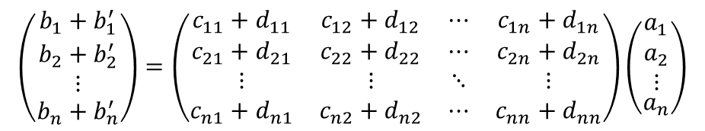
Matrix
这种定义的合理性源自对线性方程组的变形：
$$b_{1}=c_{11}a_{1}+c_{12}a_{2}+⋯+c_{1n}a_{n}$$
$$b_{2}=c_{21}a_{1}+c_{22}a_{2}+⋯+c_{2n}a_{n}$$
$$⋯$$
$$b_{n}=c_{n1}a_{1}+c_{n2}a_{2}+⋯+c_{nn}a_{n}$$
$$b_{1}^{′}=d_{11}a_{1}+d_{12}a_{2}+⋯+d_{1n}a_{n}$$
$$b_{2}^{′}=d_{21}a_{1}+d_{22}a_{2}+⋯+d_{2n}a_{n}$$
$$⋯$$
$$b_{n}^{′}=d_{n1}a_{1}+d_{n2}a_{2}+⋯+d_{nn}a_{n}$$
$$b_{1}+b_{1}^{′}=\left(c_{11}+d_{11}\right)a_{1}+\left(c_{12}+d_{12}\right)a_{2}+⋯+\left(c_{1n}+d_{1n}\right)a_{n}$$
$$b_{2}+b_{2}^{′}=\left(c_{21}+d_{21}\right)a_{1}+\left(c_{22}+d_{22}\right)a_{2}+⋯+\left(c_{2n}+d_{2n}\right)a_{n}$$
$$⋯$$
$$b_{n}+b_{n}^{′}=\left(c_{n1}+d_{n1}\right)a_{1}+\left(c_{n2}+d_{n2}\right)a_{2}+⋯+\left(c_{nn}+d_{nn}\right)a_{n}$$
$$kb_{1}=\left(kc_{11}\right)a_{1}+\left(kc_{12}\right)a_{2}+⋯+\left(kc_{1n}\right)a_{n}$$
$$kb_{2}=\left(kc_{21}\right)a_{1}+\left(kc_{22}\right)a_{2}+⋯+\left(kc_{2n}\right)a_{n}$$
$$⋯$$
$$kb_{n}=\left(kc_{n1}\right)a_{1}+\left(kc_{n2}\right)a_{2}+⋯+\left(kc_{nn}\right)a_{n}$$
$$\left(\begin{aligned}\begin{matrix}b_{1}+b_{1}^{′} \\ b_{2}+b_{2}^{′} \\ ⋮\end{matrix} \\ b_{n}+b_{n}^{′}\end{aligned}\right)=\left(\begin{matrix}c_{11}+d_{11} & c_{12}+d_{12} & ⋯ & c_{1n}+d_{1n} \\ c_{21}+d_{21} & c_{22}+d_{22} & ⋯ & c_{2n}+d_{2n} \\ ⋮ & ⋮ & ⋱ & ⋮ \\ c_{n1}+d_{n1} & c_{n2}+d_{n2} & ⋯ & c_{nn}+d_{nn}\end{matrix}\right)\left(\begin{aligned}\begin{matrix}a_{1} \\ a_{2} \\ ⋮\end{matrix} \\ a_{n}\end{aligned}\right)$$
$$\left(\begin{aligned}\begin{matrix}{kb}_{1} \\ {kb}_{2} \\ ⋮\end{matrix} \\ {kb}_{n}\end{aligned}\right)=\left(\begin{matrix}{kc}_{11} & kc_{12} & ⋯ & {kc}_{1n} \\ kc_{21} & {kc}_{22} & ⋯ & kc_{2n} \\ ⋮ & ⋮ & ⋱ & ⋮ \\ kc_{n1} & kc_{n2} & ⋯ & kc_{nn}\end{matrix}\right)\left(\begin{aligned}\begin{matrix}a_{1} \\ a_{2} \\ ⋮\end{matrix} \\ a_{n}\end{aligned}\right)$$

Slide 9
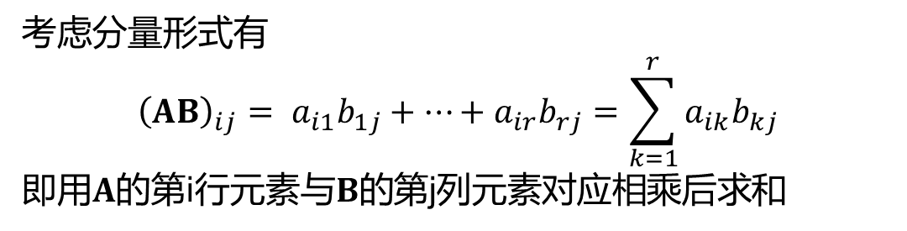

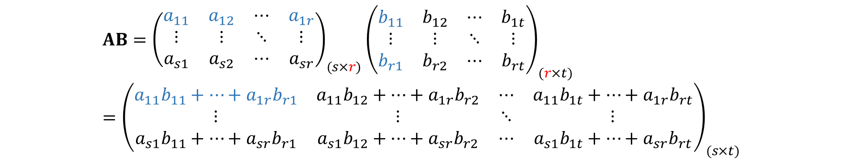
Matrix
矩阵的乘法：
设$A$是$s×r$矩阵，$B$是$r×t$矩阵
$$AB={\left(\begin{matrix}a_{11} & a_{12} & ⋯ & a_{1r} \\ ⋮ & ⋮ & ⋱ & ⋮ \\ a_{s1} & a_{s2} & ⋯ & a_{sr}\end{matrix}\right)}_{(s×r)}{\left(\begin{matrix}b_{11} & b_{12} & ⋯ & b_{1t} \\ ⋮ & ⋮ & ⋱ & ⋮ \\ b_{r1} & b_{r2} & ⋯ & b_{rt}\end{matrix}\right)}_{(r×t)}={\left(\begin{matrix}a_{11}b_{11}+⋯+a_{1r}b_{r1} & a_{11}b_{12}+⋯+a_{1r}b_{r2} & ⋯ & a_{11}b_{1t}+⋯+a_{1r}b_{rt} \\ ⋮ & ⋮ & ⋱ & ⋮ \\ a_{s1}b_{11}+⋯+a_{sr}b_{r1} & a_{s1}b_{12}+⋯+a_{sr}b_{r2} & ⋯ & a_{s1}b_{1t}+⋯+a_{sr}b_{rt}\end{matrix}\right)}_{(s×t)}$$
结果是一个$s×t$矩阵
考虑分量形式有
$${\left(AB\right)}_{ij}= a_{i1}b_{1j}+⋯+a_{ir}b_{rj}=\sum_{k=1}^{r}{a_{ik}b_{kj}}$$
即用$A$的第i行元素与$B$的第j列元素对应相乘后求和

Slide 10


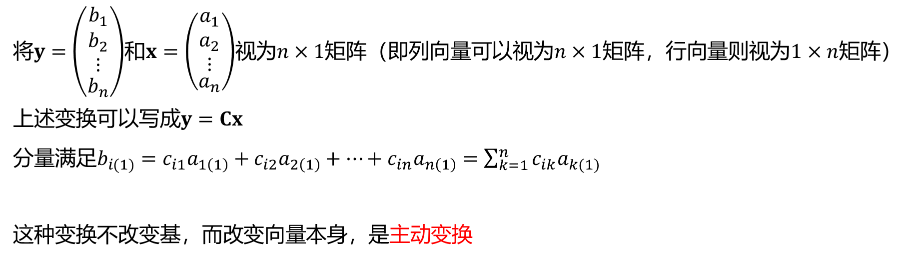
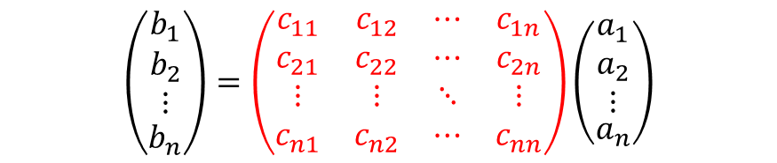


Linear transformation
回到线性变换
$$\left(\begin{aligned}\begin{matrix}b_{1} \\ b_{2} \\ ⋮\end{matrix} \\ b_{n}\end{aligned}\right)=\left(\begin{matrix}c_{11} & c_{12} & ⋯ & c_{1n} \\ c_{21} & c_{22} & ⋯ & c_{2n} \\ ⋮ & ⋮ & ⋱ & ⋮ \\ c_{n1} & c_{n2} & ⋯ & c_{nn}\end{matrix}\right)\left(\begin{aligned}\begin{matrix}a_{1} \\ a_{2} \\ ⋮\end{matrix} \\ a_{n}\end{aligned}\right)$$
将$y=\left(\begin{aligned}\begin{matrix}b_{1} \\ b_{2} \\ ⋮\end{matrix} \\ b_{n}\end{aligned}\right)$和$x=\left(\begin{aligned}\begin{matrix}a_{1} \\ a_{2} \\ ⋮\end{matrix} \\ a_{n}\end{aligned}\right)$视为$n×1$矩阵（即列向量可以视为$n×1$矩阵，行向量则视为$1×n$矩阵）
上述变换可以写成$y=Cx$
分量满足$b_{i(1)}=c_{i1}a_{1\left(1\right)}+c_{i2}a_{2\left(1\right)}+⋯+c_{in}a_{n\left(1\right)}=\sum_{k=1}^{n}{c_{ik}a_{k(1)}}$
这种变换不改变基，而改变向量本身，是主动变换
$${\vec{e}}_{y}$$
$$\vec{β}$$
$$\vec{α}$$
$${\vec{e}}_{x}$$

Slide 11
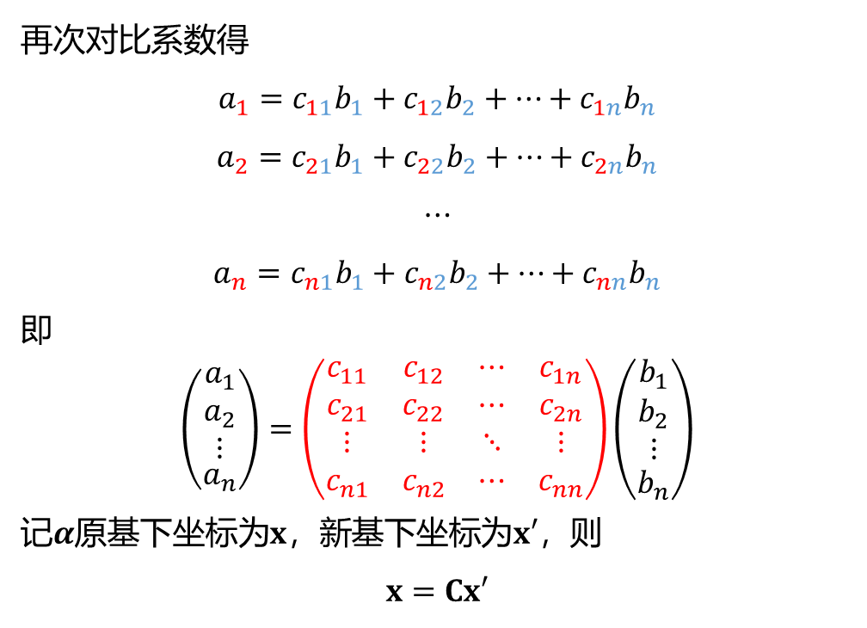
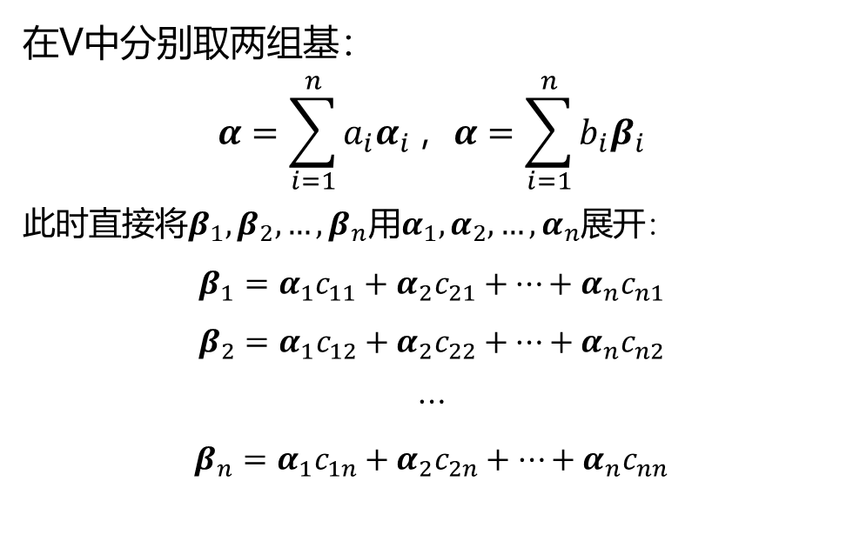
Linear transformation
被动变换
再次对比系数得
$$a_{1}=c_{11}b_{1}+c_{12}b_{2}+⋯+c_{1n}b_{n}$$
$$a_{2}=c_{21}b_{1}+c_{22}b_{2}+⋯+c_{2n}b_{n}$$
$$⋯$$
$$a_{n}=c_{n1}b_{1}+c_{n2}b_{2}+⋯+c_{nn}b_{n}$$
即
$$\left(\begin{aligned}\begin{matrix}a_{1} \\ a_{2} \\ ⋮\end{matrix} \\ a_{n}\end{aligned}\right)=\left(\begin{matrix}c_{11} & c_{12} & ⋯ & c_{1n} \\ c_{21} & c_{22} & ⋯ & c_{2n} \\ ⋮ & ⋮ & ⋱ & ⋮ \\ c_{n1} & c_{n2} & ⋯ & c_{nn}\end{matrix}\right)\left(\begin{aligned}\begin{matrix}b_{1} \\ b_{2} \\ ⋮\end{matrix} \\ b_{n}\end{aligned}\right)$$
记$α$原基下坐标为$x$，新基下坐标为$x′$，则
$$x=Cx′$$
在V中分别取两组基：
$$α=\sum_{i=1}^{n}{a_{i}α_{i}}，α=\sum_{i=1}^{n}{b_{i}β_{i}}$$
此时直接将$β_{1}, β_{2}, …,β_{n}$用$α_{1}, α_{2}, …,α_{n}$展开：
$$β_{1}=α_{1}c_{11}+α_{2}c_{21}+⋯+α_{n}c_{n1}$$
$$β_{2}=α_{1}c_{12}+α_{2}c_{22}+⋯+α_{n}c_{n2}$$
$$⋯$$
$$β_{n}=α_{1}c_{1n}+α_{2}c_{2n}+⋯+α_{n}c_{nn}$$

Slide 12



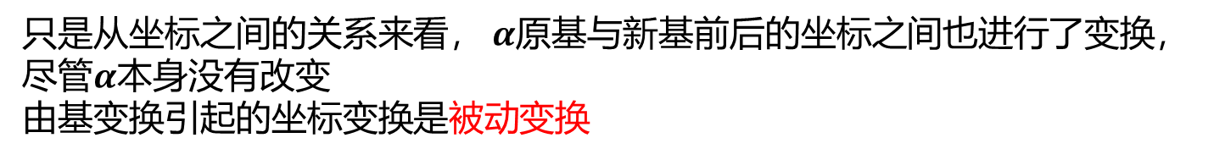
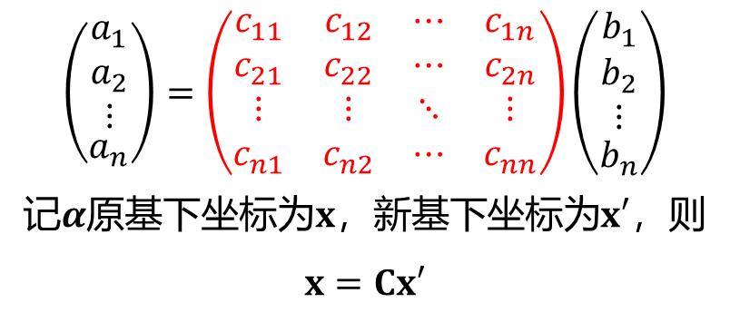


Linear transformation
被动变换
$${\vec{e}}_{y}$$
$${\vec{e}}_{y}′$$
$$\left(\begin{aligned}\begin{matrix}a_{1} \\ a_{2} \\ ⋮\end{matrix} \\ a_{n}\end{aligned}\right)=\left(\begin{matrix}c_{11} & c_{12} & ⋯ & c_{1n} \\ c_{21} & c_{22} & ⋯ & c_{2n} \\ ⋮ & ⋮ & ⋱ & ⋮ \\ c_{n1} & c_{n2} & ⋯ & c_{nn}\end{matrix}\right)\left(\begin{aligned}\begin{matrix}b_{1} \\ b_{2} \\ ⋮\end{matrix} \\ b_{n}\end{aligned}\right)$$
记$α$原基下坐标为$x$，新基下坐标为$x′$，则
$$x=Cx′$$
$$\vec{α}$$
$${\vec{e}}_{x}$$
$${\vec{e}}_{x}′$$
只是从坐标之间的关系来看， $α$原基与新基前后的坐标之间也进行了变换，尽管$α$本身没有改变
由基变换引起的坐标变换是被动变换

Slide 13
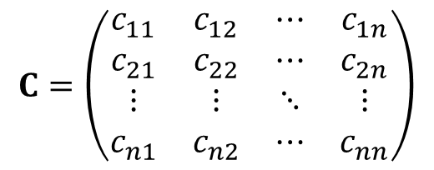
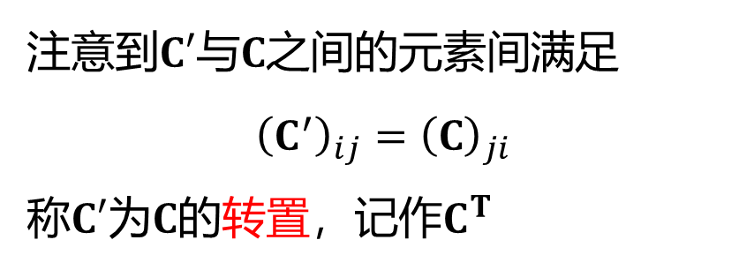
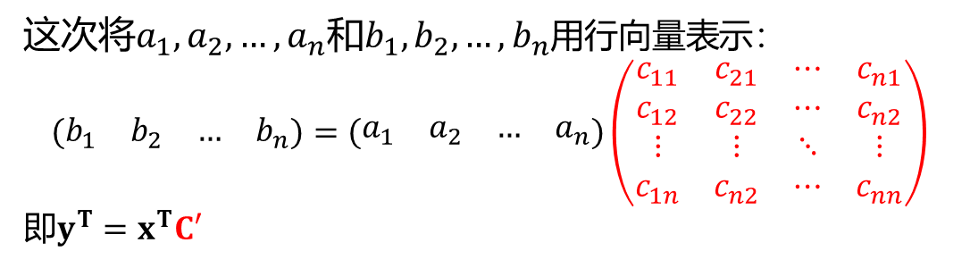
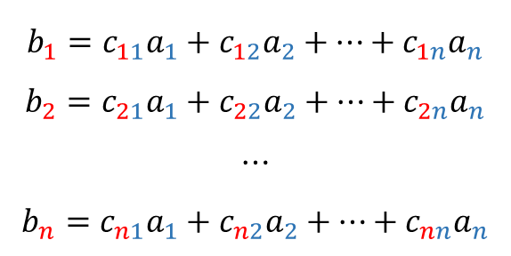
Linear transformation
行向量线性变换与矩阵的转置
$$b_{1}=c_{11}a_{1}+c_{12}a_{2}+⋯+c_{1n}a_{n}$$
$$b_{2}=c_{21}a_{1}+c_{22}a_{2}+⋯+c_{2n}a_{n}$$
$$⋯$$
$$b_{n}=c_{n1}a_{1}+c_{n2}a_{2}+⋯+c_{nn}a_{n}$$
这次将$a_{1},a_{2},…,a_{n}$和$b_{1},b_{2},…,b_{n}$用行向量表示：
$$\left(\begin{matrix}b_{1} & b_{2} & … & b_{n}\end{matrix}\right)=\left(\begin{matrix}a_{1} & a_{2} & … & a_{n}\end{matrix}\right)\left(\begin{matrix}c_{11} & c_{21} & ⋯ & c_{n1} \\ c_{12} & c_{22} & ⋯ & c_{n2} \\ ⋮ & ⋮ & ⋱ & ⋮ \\ c_{1n} & c_{n2} & ⋯ & c_{nn}\end{matrix}\right)$$
即$y^{T}=x^{T}C′$
注意到$C′$与$C$之间的元素间满足
$${\left(C^{′}\right)}_{ij}={\left(C\right)}_{ji}$$
称$C′$为$C$的转置，记作$C^{T}$
$$C=\left(\begin{matrix}c_{11} & c_{12} & ⋯ & c_{1n} \\ c_{21} & c_{22} & ⋯ & c_{2n} \\ ⋮ & ⋮ & ⋱ & ⋮ \\ c_{n1} & c_{n2} & ⋯ & c_{nn}\end{matrix}\right)$$

Slide 14

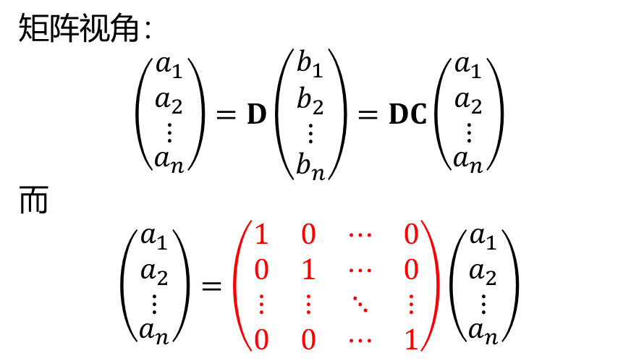
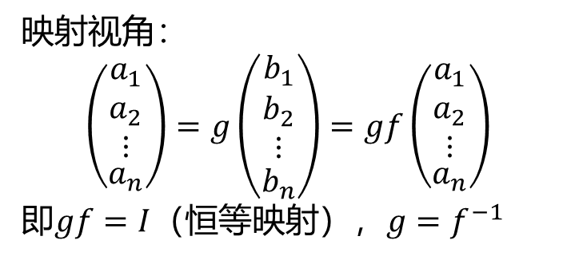
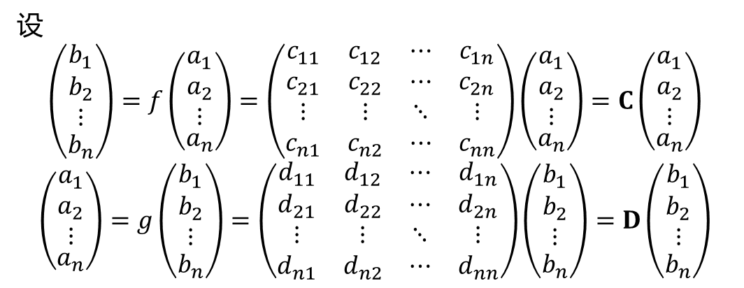

Linear transformation
逆变换与逆矩阵
无论主动变换还是被动变换，都应当有相应的逆变换，使变换后的坐标复原
设
$$\left(\begin{aligned}\begin{matrix}b_{1} \\ b_{2} \\ ⋮\end{matrix} \\ b_{n}\end{aligned}\right)=f\left(\begin{aligned}\begin{matrix}a_{1} \\ a_{2} \\ ⋮\end{matrix} \\ a_{n}\end{aligned}\right)=\left(\begin{matrix}c_{11} & c_{12} & ⋯ & c_{1n} \\ c_{21} & c_{22} & ⋯ & c_{2n} \\ ⋮ & ⋮ & ⋱ & ⋮ \\ c_{n1} & c_{n2} & ⋯ & c_{nn}\end{matrix}\right)\left(\begin{aligned}\begin{matrix}a_{1} \\ a_{2} \\ ⋮\end{matrix} \\ a_{n}\end{aligned}\right)=C\left(\begin{aligned}\begin{matrix}a_{1} \\ a_{2} \\ ⋮\end{matrix} \\ a_{n}\end{aligned}\right)$$
$$\left(\begin{aligned}\begin{matrix}a_{1} \\ a_{2} \\ ⋮\end{matrix} \\ a_{n}\end{aligned}\right)=g\left(\begin{aligned}\begin{matrix}b_{1} \\ b_{2} \\ ⋮\end{matrix} \\ b_{n}\end{aligned}\right)=\left(\begin{matrix}d_{11} & d_{12} & ⋯ & d_{1n} \\ d_{21} & d_{22} & ⋯ & d_{2n} \\ ⋮ & ⋮ & ⋱ & ⋮ \\ d_{n1} & d_{n2} & ⋯ & d_{nn}\end{matrix}\right)\left(\begin{aligned}\begin{matrix}b_{1} \\ b_{2} \\ ⋮\end{matrix} \\ b_{n}\end{aligned}\right)=D\left(\begin{aligned}\begin{matrix}b_{1} \\ b_{2} \\ ⋮\end{matrix} \\ b_{n}\end{aligned}\right)$$
矩阵视角：
$$\left(\begin{aligned}\begin{matrix}a_{1} \\ a_{2} \\ ⋮\end{matrix} \\ a_{n}\end{aligned}\right)=D\left(\begin{aligned}\begin{matrix}b_{1} \\ b_{2} \\ ⋮\end{matrix} \\ b_{n}\end{aligned}\right)=DC\left(\begin{aligned}\begin{matrix}a_{1} \\ a_{2} \\ ⋮\end{matrix} \\ a_{n}\end{aligned}\right)$$
而
$$\left(\begin{aligned}\begin{matrix}a_{1} \\ a_{2} \\ ⋮\end{matrix} \\ a_{n}\end{aligned}\right)=\left(\begin{matrix}1 & 0 & ⋯ & 0 \\ 0 & 1 & ⋯ & 0 \\ ⋮ & ⋮ & ⋱ & ⋮ \\ 0 & 0 & ⋯ & 1\end{matrix}\right)\left(\begin{aligned}\begin{matrix}a_{1} \\ a_{2} \\ ⋮\end{matrix} \\ a_{n}\end{aligned}\right)$$
映射视角：
$$\left(\begin{aligned}\begin{matrix}a_{1} \\ a_{2} \\ ⋮\end{matrix} \\ a_{n}\end{aligned}\right)=g\left(\begin{aligned}\begin{matrix}b_{1} \\ b_{2} \\ ⋮\end{matrix} \\ b_{n}\end{aligned}\right)=gf\left(\begin{aligned}\begin{matrix}a_{1} \\ a_{2} \\ ⋮\end{matrix} \\ a_{n}\end{aligned}\right)$$
即$gf=I$（恒等映射），$g=f^{−1}$
单位矩阵（I）
$f^{−1}$对应的矩阵就是$C^{−1}$
那么$DC=I$，记$D≔C^{−1}$为$C$的逆矩阵

Slide 15
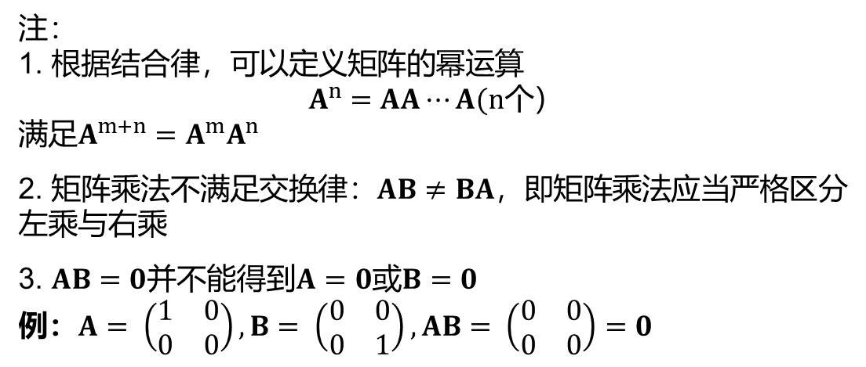
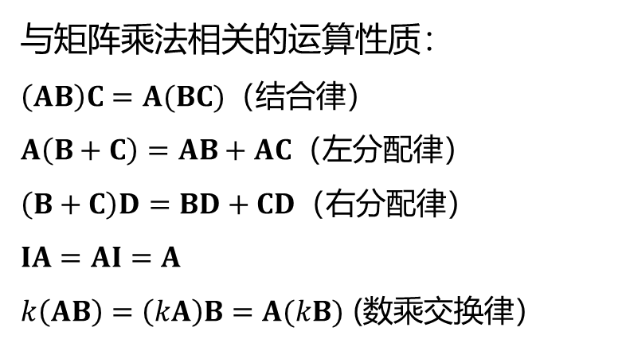
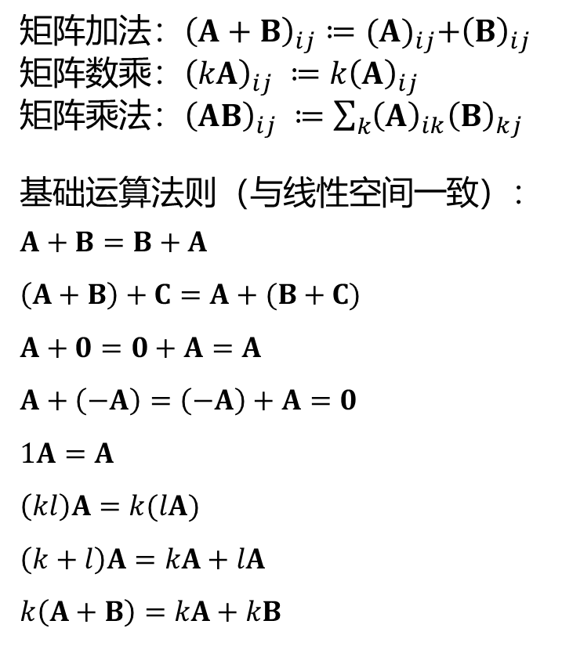
Properties of matrices
现在问题可以由研究线性变换转化为研究矩阵间的运算关系
矩阵加法：${\left(A+B\right)}_{ij}≔{(A)}_{ij}+{\left(B\right)}_{ij}$
矩阵数乘：${\left(kA\right)}_{ij} ≔k{\left(A\right)}_{ij}$
矩阵乘法：${\left(AB\right)}_{ij} ≔\sum_{k}{{\left(A\right)}_{ik}{\left(B\right)}_{kj}}$
基础运算法则（与线性空间一致）：
$$A+B=B+A$$
$$\left(A+B\right)+C=A+(B+C)$$
$$A+0=0+A=A$$
$$A+\left(−A\right)=\left(−A\right)+A=0$$
$$1A=A$$
$$\left(kl\right)A=k(lA)$$
$$\left(k+l\right)A=kA+lA$$
$$k\left(A+B\right)=kA+kB$$
与矩阵乘法相关的运算性质：
$\left(AB\right)C=A(BC)$（结合律）
$A\left(B+C\right)=AB+AC$（左分配律）
$\left(B+C\right)D=BD+CD$（右分配律）
$$IA=AI=A$$
$k\left(AB\right)=\left(kA\right)B=A(kB)$ (数乘交换律）
注：
1. 根据结合律，可以定义矩阵的幂运算
$$A^{n}=AA⋯A(n个）$$
满足$A^{m+n}=A^{m}A^{n}$
2. 矩阵乘法不满足交换律：$AB≠BA$，即矩阵乘法应当严格区分左乘与右乘
3. $AB=0$并不能得到$A=0$或$B=0$
例：$A= \left(\begin{matrix}1 & 0 \\ 0 & 0\end{matrix}\right), B= \left(\begin{matrix}0 & 0 \\ 0 & 1\end{matrix}\right), AB= \left(\begin{matrix}0 & 0 \\ 0 & 0\end{matrix}\right)=0$

Slide 16
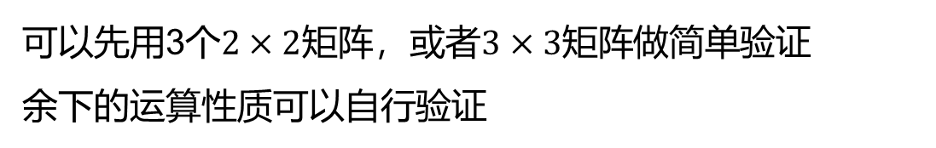

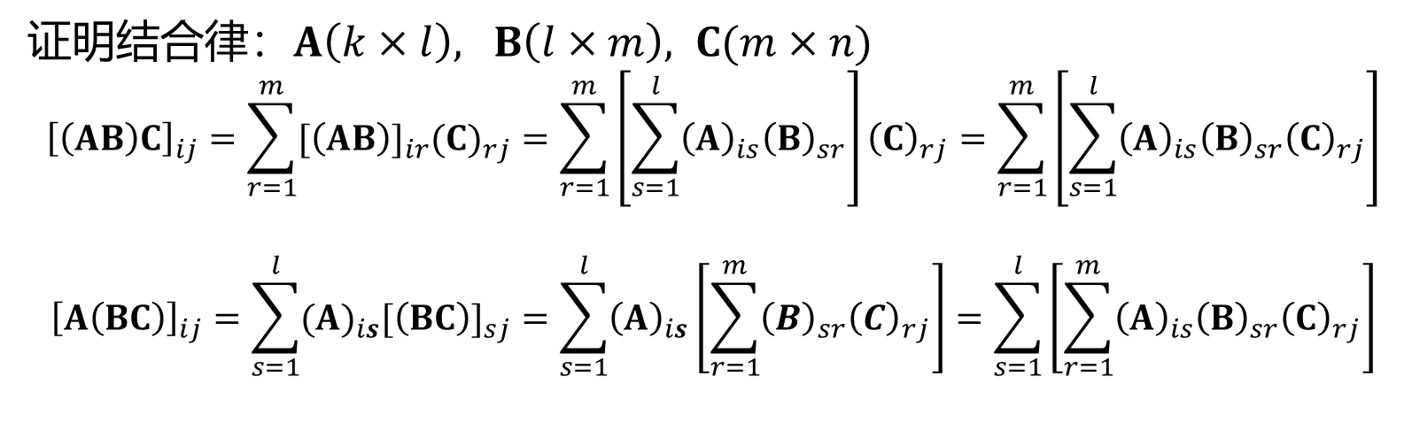
Properties of matrices
证明结合律：$A\left(k×l\right), B\left(l×m\right), C(m×n)$
$${\left[\left(AB\right)C\right]}_{ij}=\sum_{r=1}^{m}{{[\left(AB\right)]}_{ir}{(C)}_{rj}}=\sum_{r=1}^{m}{\left[\sum_{s=1}^{l}{{\left(A\right)}_{is}{\left(B\right)}_{sr}}\right]{\left(C\right)}_{rj}}=\sum_{r=1}^{m}{\left[\sum_{s=1}^{l}{{\left(A\right)}_{is}{\left(B\right)}_{sr}{\left(C\right)}_{rj}}\right]}$$
$${\left[A\left(BC\right)\right]}_{ij}=\sum_{s=1}^{l}{{(A)}_{is}{[\left(BC\right)]}_{sj}}=\sum_{s=1}^{l}{{\left(A\right)}_{is}\left[\sum_{r=1}^{m}{{\left(B\right)}_{sr}{\left(C\right)}_{rj}}\right]}=\sum_{s=1}^{l}{\left[\sum_{r=1}^{m}{{\left(A\right)}_{is}{\left(B\right)}_{sr}{\left(C\right)}_{rj}}\right]}$$
$$=$$
可以先用3个$2×2$矩阵，或者$3×3$矩阵做简单验证
余下的运算性质可以自行验证

Slide 17
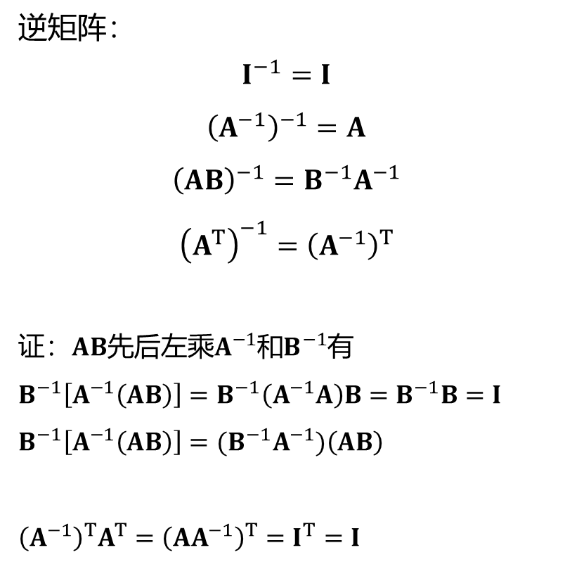
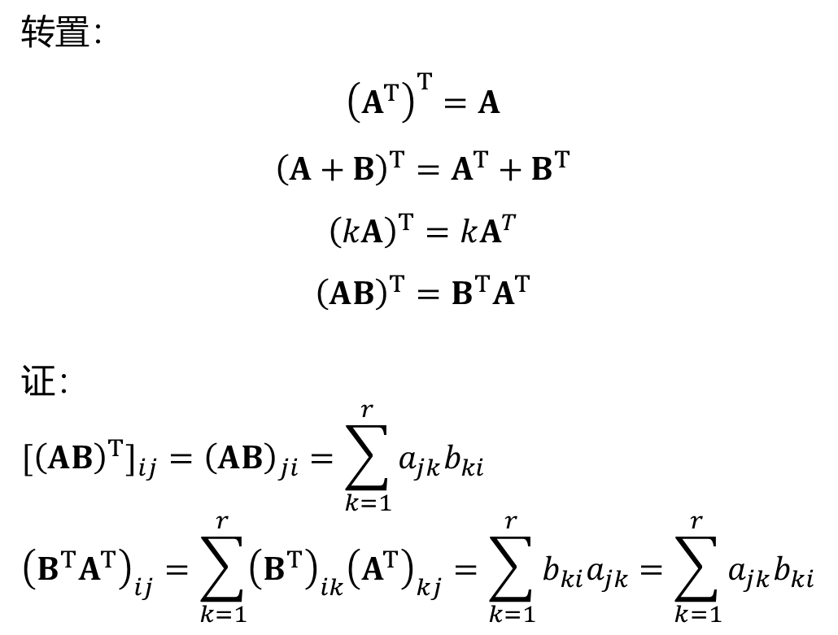
Properties of matrices
与转置和逆矩阵有关的运算性质
转置：
$${\left(A^{T}\right)}^{T}=A$$
$${\left(A+B\right)}^{T}=A^{T}+B^{T}$$
$${\left(kA\right)}^{T}=kA^{T}$$
$${\left(AB\right)}^{T}=B^{T}A^{T}$$
证：
$${{[\left(AB\right)}^{T}]}_{ij}={\left(AB\right)}_{ji}=\sum_{k=1}^{r}{a_{jk}b_{ki}}$$
$${\left(B^{T}A^{T}\right)}_{ij}=\sum_{k=1}^{r}{{\left(B^{T}\right)}_{ik}{\left(A^{T}\right)}_{kj}}=\sum_{k=1}^{r}{b_{ki}a_{jk}}=\sum_{k=1}^{r}{a_{jk}b_{ki}}$$
逆矩阵：
$$I^{−1}=I$$
$${\left(A^{−1}\right)}^{−1}=A$$
$${\left(AB\right)}^{−1}=B^{−1}A^{−1}$$
$${\left(A^{T}\right)}^{−1}={\left(A^{−1}\right)}^{T}$$
证：$AB$先后左乘$A^{−1}$和$B^{−1}$有
$$B^{−1}\left[A^{−1}\left(AB\right)\right]=B^{−1}\left(A^{−1}A\right)B=B^{−1}B=I$$
$$B^{−1}\left[A^{−1}\left(AB\right)\right]=(B^{−1}A^{−1})\left(AB\right)$$
$${\left(A^{−1}\right)}^{T}A^{T}={\left(AA^{−1}\right)}^{T}=I^{T}=I$$

Slide 18

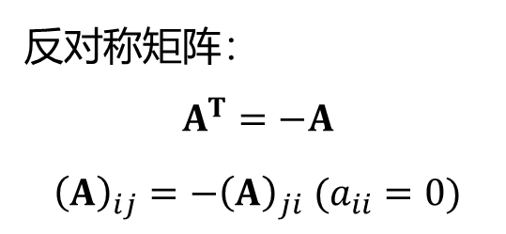
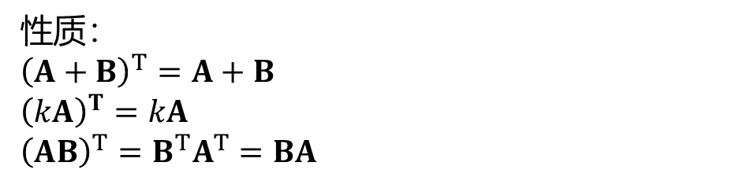
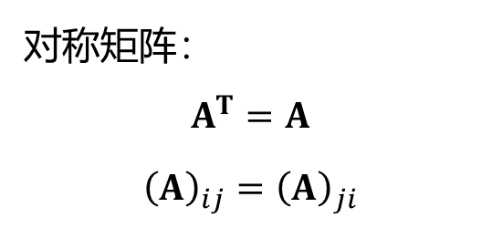
Special matrices
对称矩阵与反对称矩阵
对称矩阵：
$$A^{T}=A$$
$${\left(A\right)}_{ij}={\left(A\right)}_{ji}$$
性质：
$${\left(A+B\right)}^{T}=A+B$$
$${\left(kA\right)}^{T}=kA$$
$${\left(AB\right)}^{T}=B^{T}A^{T}=BA$$
反对称矩阵：
$$A^{T}=−A$$
$${\left(A\right)}_{ij}={−\left(A\right)}_{ji} (a_{ii}=0)$$
任一n阶矩阵都可以唯一地表示成一个对称矩阵和一个反对称矩阵之和：
$$A=\frac{1}{2}\left(A+A^{T}\right)+\frac{1}{2}\left(A −A^{T}\right)$$
$${\left(A+A^{T}\right)}^{T}=A^{T}+A=A+A^{T}$$
$${\left(A −A^{T}\right)}^{T}=A^{T}−A=−\left(A −A^{T}\right)$$

Slide 19
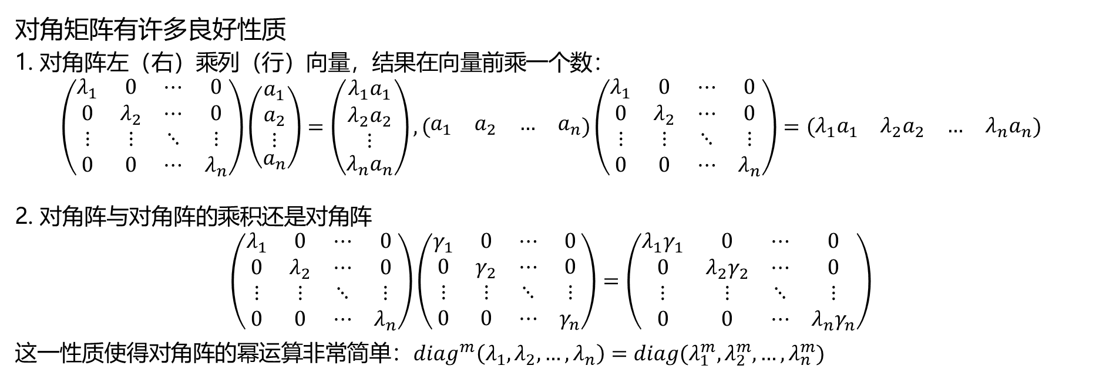

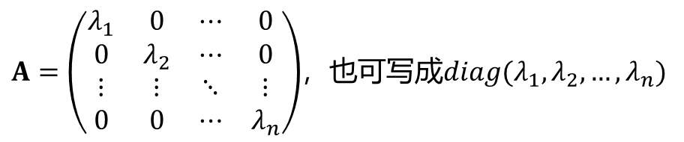
Special matrices
对角矩阵
从线性变换视角看，新基相较于原基仅在前面乘上一个数：
$$f\left(e_{i}\right)=λ_{i}e_{i}$$
（本征值问题，下一节讨论）
$A=\left(\begin{matrix}λ_{1} & 0 & ⋯ & 0 \\ 0 & λ_{2} & ⋯ & 0 \\ ⋮ & ⋮ & ⋱ & ⋮ \\ 0 & 0 & ⋯ & λ_{n}\end{matrix}\right)$，也可写成$diag(λ_{1}, λ_{2},…,λ_{n})$
对角矩阵有许多良好性质
1. 对角阵左（右）乘列（行）向量，结果在向量前乘一个数：
$$\left(\begin{matrix}λ_{1} & 0 & ⋯ & 0 \\ 0 & λ_{2} & ⋯ & 0 \\ ⋮ & ⋮ & ⋱ & ⋮ \\ 0 & 0 & ⋯ & λ_{n}\end{matrix}\right)\left(\begin{aligned}\begin{matrix}a_{1} \\ a_{2} \\ ⋮\end{matrix} \\ a_{n}\end{aligned}\right)=\left(\begin{aligned}\begin{matrix}{λ_{1}a}_{1} \\ {λ_{2}a}_{2} \\ ⋮\end{matrix} \\ {λ_{n}a}_{n}\end{aligned}\right),\left(\begin{matrix}a_{1} & a_{2} & … & a_{n}\end{matrix}\right)\left(\begin{matrix}λ_{1} & 0 & ⋯ & 0 \\ 0 & λ_{2} & ⋯ & 0 \\ ⋮ & ⋮ & ⋱ & ⋮ \\ 0 & 0 & ⋯ & λ_{n}\end{matrix}\right)=\left(\begin{matrix}{λ_{1}a}_{1} & {λ_{2}a}_{2} & … & {λ_{n}a}_{n}\end{matrix}\right)$$
2. 对角阵与对角阵的乘积还是对角阵
$$\left(\begin{matrix}λ_{1} & 0 & ⋯ & 0 \\ 0 & λ_{2} & ⋯ & 0 \\ ⋮ & ⋮ & ⋱ & ⋮ \\ 0 & 0 & ⋯ & λ_{n}\end{matrix}\right)\left(\begin{matrix}γ_{1} & 0 & ⋯ & 0 \\ 0 & γ_{2} & ⋯ & 0 \\ ⋮ & ⋮ & ⋱ & ⋮ \\ 0 & 0 & ⋯ & γ_{n}\end{matrix}\right)=\left(\begin{matrix}λ_{1}γ_{1} & 0 & ⋯ & 0 \\ 0 & λ_{2}γ_{2} & ⋯ & 0 \\ ⋮ & ⋮ & ⋱ & ⋮ \\ 0 & 0 & ⋯ & λ_{n}γ_{n}\end{matrix}\right)$$
这一性质使得对角阵的幂运算非常简单：$diag^{m}\left(λ_{1}, λ_{2},…,λ_{n}\right)=diag(λ_{1}^{m}, λ_{2}^{m},…,λ_{n}^{m})$

Slide 20
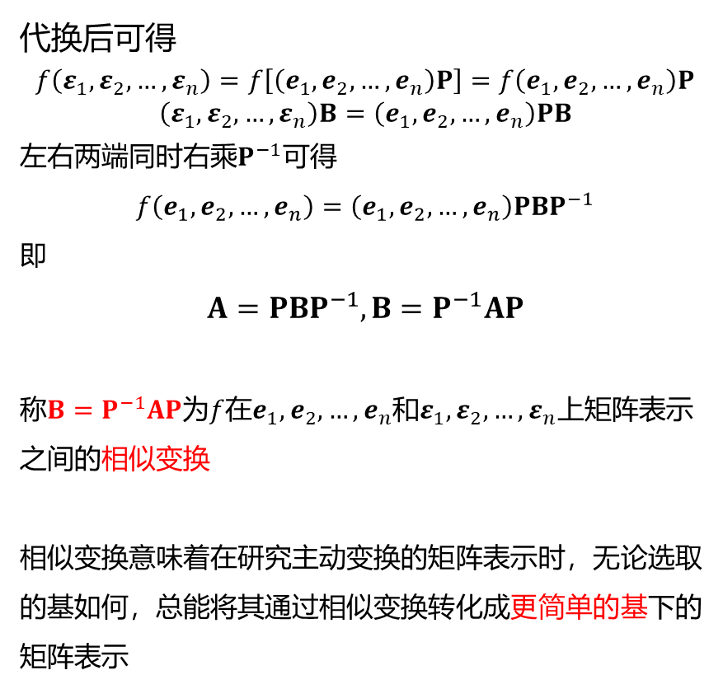
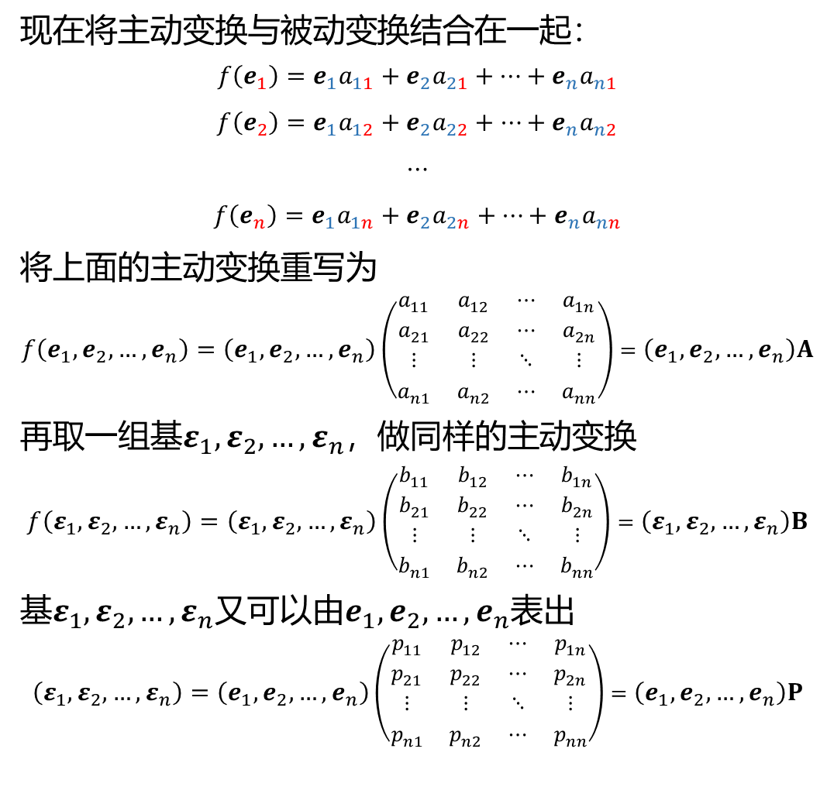
Similarity transformation
现在将主动变换与被动变换结合在一起：
$$f\left(e_{1}\right)={e_{1}a}_{11}+{e_{2}a}_{21}+⋯+{e_{n}a}_{n1}$$
$$f\left(e_{2}\right)={e_{1}a}_{12}+{e_{2}a}_{22}+⋯+{e_{n}a}_{n2}$$
$$⋯$$
$$f\left(e_{n}\right)={e_{1}a}_{1n}+{e_{2}a}_{2n}+⋯+{e_{n}a}_{nn}$$
将上面的主动变换重写为
$$f\left(e_{1}, e_{2},…,e_{n}\right)=\left(e_{1}, e_{2},…,e_{n}\right)\left(\begin{matrix}a_{11} & a_{12} & ⋯ & a_{1n} \\ a_{21} & a_{22} & ⋯ & a_{2n} \\ ⋮ & ⋮ & ⋱ & ⋮ \\ a_{n1} & a_{n2} & ⋯ & a_{nn}\end{matrix}\right)=\left(e_{1}, e_{2},…,e_{n}\right)A$$
再取一组基$ε_{1}, ε_{2},…,ε_{n}$，做同样的主动变换
$$f\left(ε_{1}, ε_{2},…,ε_{n}\right)=\left(ε_{1}, ε_{2},…,ε_{n}\right)\left(\begin{matrix}b_{11} & b_{12} & ⋯ & b_{1n} \\ b_{21} & b_{22} & ⋯ & b_{2n} \\ ⋮ & ⋮ & ⋱ & ⋮ \\ b_{n1} & b_{n2} & ⋯ & b_{nn}\end{matrix}\right)=\left(ε_{1}, ε_{2},…,ε_{n}\right)B$$
基$ε_{1}, ε_{2},…,ε_{n}$又可以由$e_{1}, e_{2},…,e_{n}$表出
$$\left(ε_{1}, ε_{2},…,ε_{n}\right)=\left(e_{1}, e_{2},…,e_{n}\right)\left(\begin{matrix}p_{11} & p_{12} & ⋯ & p_{1n} \\ p_{21} & p_{22} & ⋯ & p_{2n} \\ ⋮ & ⋮ & ⋱ & ⋮ \\ p_{n1} & p_{n2} & ⋯ & p_{nn}\end{matrix}\right)=\left(e_{1}, e_{2},…,e_{n}\right)P$$
代换后可得
$$f\left(ε_{1}, ε_{2},…,ε_{n}\right)=f\left[\left(e_{1}, e_{2},…,e_{n}\right)P\right]=f\left(e_{1}, e_{2},…,e_{n}\right)P$$
$$\left(ε_{1}, ε_{2},…,ε_{n}\right)B=\left(e_{1}, e_{2},…,e_{n}\right)PB$$
左右两端同时右乘$P^{−1}$可得
$$f\left(e_{1}, e_{2},…,e_{n}\right)=\left(e_{1}, e_{2},…,e_{n}\right)PBP^{−1}$$
即
$$A=PBP^{−1}, B=P^{−1}AP$$
称$B=P^{−1}AP$为$f$在$e_{1}, e_{2},…,e_{n}$和$ε_{1}, ε_{2},…,ε_{n}$上矩阵表示之间的相似变换
相似变换意味着在研究主动变换的矩阵表示时，无论选取的基如何，总能将其通过相似变换转化成更简单的基下的矩阵表示

Slide 21
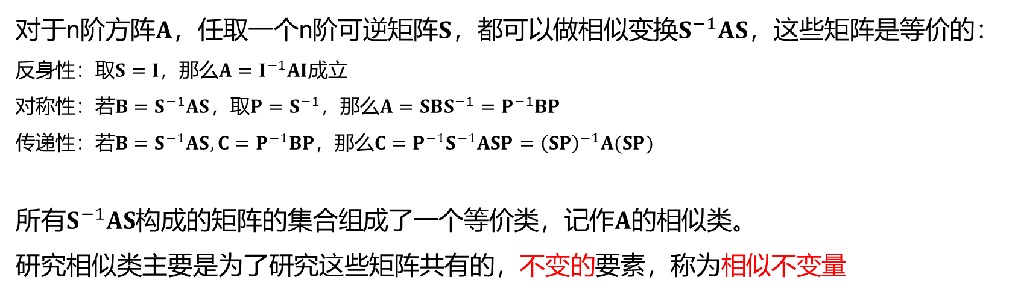
Similarity invariant
对于n阶方阵$A$，任取一个n阶可逆矩阵$S$，都可以做相似变换$S^{−1}AS$，这些矩阵是等价的：
反身性：取$S=I$，那么$A=I^{−1}AI$成立
对称性：若$B=S^{−1}AS$，取$P=S^{−1}$，那么$A=SBS^{−1}=P^{−1}BP$
传递性：若$B=S^{−1}AS,C=P^{−1}BP$，那么$C=P^{−1}S^{−1}ASP={\left(SP\right)}^{−1}A(SP)$
所有$S^{−1}AS$构成的矩阵的集合组成了一个等价类，记作$A$的相似类。
研究相似类主要是为了研究这些矩阵共有的，不变的要素，称为相似不变量
最常见的相似不变量有两个：矩阵的行列式和迹

Slide 22
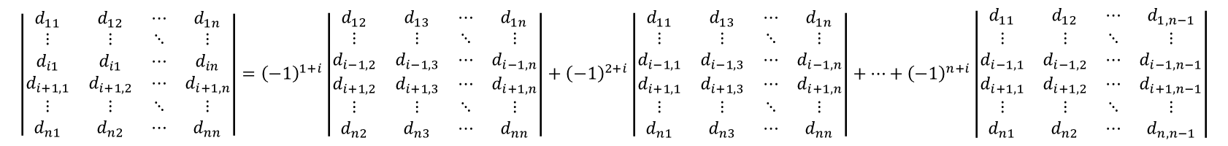
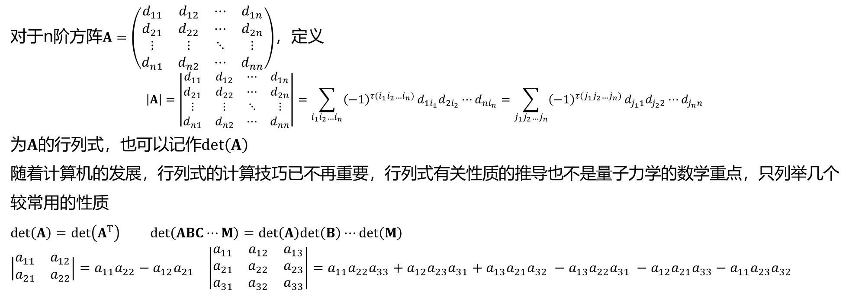
Similarity invariant: Determinant
矩阵的行列式
对于n阶方阵$A=\left(\begin{matrix}d_{11} & d_{12} & ⋯ & d_{1n} \\ d_{21} & d_{22} & ⋯ & d_{2n} \\ ⋮ & ⋮ & ⋱ & ⋮ \\ d_{n1} & d_{n2} & ⋯ & d_{nn}\end{matrix}\right)$，定义
$$\left|A\right|=\left|\begin{matrix}d_{11} & d_{12} & ⋯ & d_{1n} \\ d_{21} & d_{22} & ⋯ & d_{2n} \\ ⋮ & ⋮ & ⋱ & ⋮ \\ d_{n1} & d_{n2} & ⋯ & d_{nn}\end{matrix}\right|=\sum_{i_{1}i_{2}…i_{n}}{{\left(−1\right)}^{τ(i_{1}i_{2}…i_{n})}}d_{1i_{1}}d_{2i_{2}}⋯d_{ni_{n}}=\sum_{j_{1}j_{2}…j_{n}}{{\left(−1\right)}^{τ(j_{1}j_{2}…j_{n})}}d_{j_{1}1}d_{j_{2}2}⋯d_{j_{n}n}$$
为$A$的行列式，也可以记作$det\left(A\right)$
随着计算机的发展，行列式的计算技巧已不再重要，行列式有关性质的推导也不是量子力学的数学重点，只列举几个较常用的性质
$det\left(A\right)=det\left(A^{T}\right)$ $det\left(ABC⋯M\right)=det\left(A\right)det\left(B\right)⋯det\left(M\right)$
$\left|\begin{matrix}a_{11} & a_{12} \\ a_{21} & a_{22}\end{matrix}\right|=a_{11}a_{22}−a_{12}a_{21}$ $\left|\begin{matrix}a_{11} & a_{12} & a_{13} \\ a_{21} & a_{22} & a_{23} \\ a_{31} & a_{32} & a_{33}\end{matrix}\right|=a_{11}a_{22}a_{33}+a_{12}a_{23}a_{31}+a_{13}a_{21}a_{32} −a_{13}a_{22}a_{31} −a_{12}a_{21}a_{33}−a_{11}a_{23}a_{32}$
$$\left|\begin{matrix}d_{11} & d_{12} & ⋯ & d_{1n} \\ ⋮ & ⋮ & ⋱ & ⋮ \\ d_{i1} & d_{i1} & ⋯ & d_{in} \\ d_{i+1,1} & d_{i+1,2} & ⋯ & d_{i+1,n} \\ ⋮ & ⋮ & ⋱ & ⋮ \\ d_{n1} & d_{n2} & ⋯ & d_{nn}\end{matrix}\right|={\left(−1\right)}^{1+i}\left|\begin{matrix}d_{12} & d_{13} & ⋯ & d_{1n} \\ ⋮ & ⋮ & ⋱ & ⋮ \\ d_{i−1,2} & d_{i−1,3} & ⋯ & d_{i−1,n} \\ d_{i+1,2} & d_{i+1,3} & ⋯ & d_{i+1,n} \\ ⋮ & ⋮ & ⋱ & ⋮ \\ d_{n2} & d_{n3} & ⋯ & d_{nn}\end{matrix}\right|+{\left(−1\right)}^{2+i}\left|\begin{matrix}d_{11} & d_{13} & ⋯ & d_{1n} \\ ⋮ & ⋮ & ⋱ & ⋮ \\ d_{i−1,1} & d_{i−1,3} & ⋯ & d_{i−1,n} \\ d_{i+1,1} & d_{i+1,3} & ⋯ & d_{i+1,n} \\ ⋮ & ⋮ & ⋱ & ⋮ \\ d_{n1} & d_{n3} & ⋯ & d_{nn}\end{matrix}\right|+⋯+{\left(−1\right)}^{n+i}\left|\begin{matrix}d_{11} & d_{12} & ⋯ & d_{1,n−1} \\ ⋮ & ⋮ & ⋱ & ⋮ \\ d_{i−1,1} & d_{i−1,2} & ⋯ & d_{i−1,n−1} \\ d_{i+1,1} & d_{i+1,2} & ⋯ & d_{i+1,n−1} \\ ⋮ & ⋮ & ⋱ & ⋮ \\ d_{n1} & d_{n2} & ⋯ & d_{n,n−1}\end{matrix}\right|$$
（在Slater行列式用到）

Slide 23
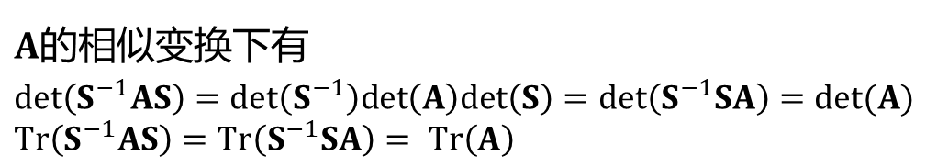
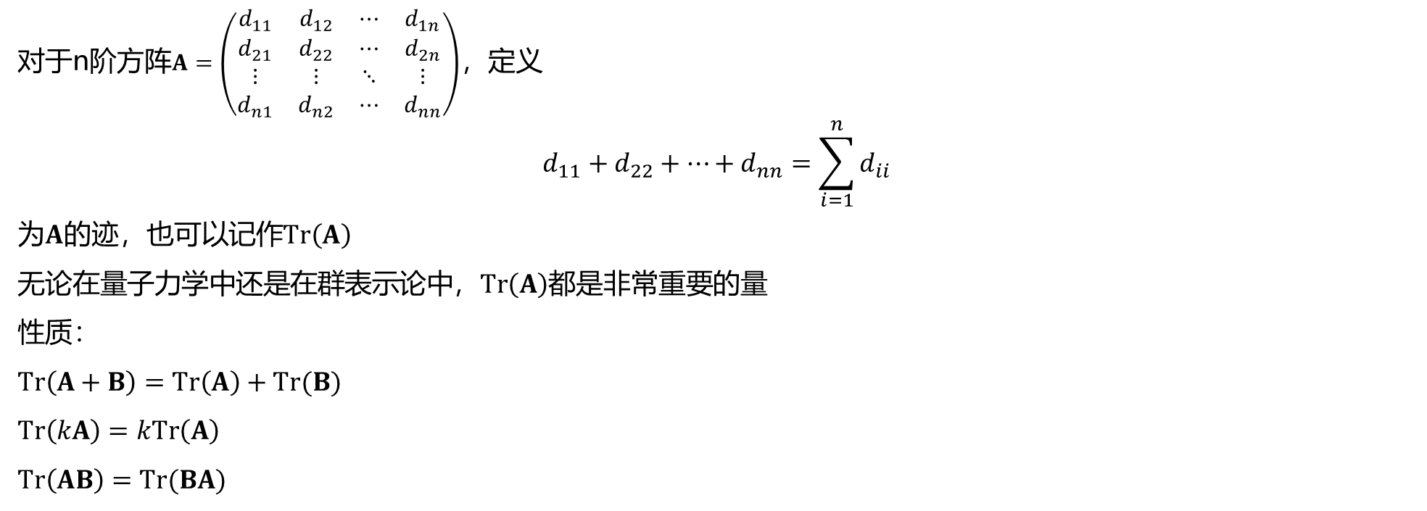
Similarity invariant: Trace
矩阵的迹
对于n阶方阵$A=\left(\begin{matrix}d_{11} & d_{12} & ⋯ & d_{1n} \\ d_{21} & d_{22} & ⋯ & d_{2n} \\ ⋮ & ⋮ & ⋱ & ⋮ \\ d_{n1} & d_{n2} & ⋯ & d_{nn}\end{matrix}\right)$，定义
$$d_{11}+d_{22}+⋯+d_{nn}=\sum_{i=1}^{n}{d_{ii}}$$
为$A$的迹，也可以记作$Tr\left(A\right)$
$\text{无论在量子力学中还是在群表示论中}$，$Tr\left(A\right)$都是非常重要的量
性质：
$$Tr\left(A+B\right)=Tr\left(A\right)+Tr(B)$$
$$Tr\left(kA\right)=kTr\left(A\right)$$
$$Tr\left(AB\right)=Tr(BA)$$
可见在行列式和迹运算中矩阵乘法都可以交换位置
$A$的相似变换下有
$$det\left(S^{−1}AS\right)=det\left(S^{−1}\right)det\left(A\right)det\left(S\right)=det\left(S^{−1}SA\right)=det(A)$$
$$Tr\left(S^{−1}AS\right)=Tr\left(S^{−1}SA\right)= Tr\left(A\right)$$
行列式和迹在相似变换下不变

Slide 24

Similarity invariant: Diagonal matrix
对角阵的行列式与迹
选取一组基，使其线性变换下的矩阵是对角阵$Λ=diag(λ_{1},λ_{2},…,λ_{n})$
$$\det\left(Λ\right)=λ_{1}λ_{2}⋯λ_{n}$$
$$Tr\left(Λ\right)=λ_{1}+λ_{2}+⋯+λ_{n}$$
结果非常简单
如果存在矩阵$P$使得$Λ=P^{−1}AP$，即$A=PΛP^{−1}$
那么$A^{n}=\left(PΛP^{−1}\right)\left(PΛP^{−1}\right)\left(PΛP^{−1}\right)⋯\left(PΛP^{−1}\right)=PΛ\left(P^{−1}P\right)Λ\left(P^{−1}P\right)Λ\left(P^{−1}⋯P\right)Λ\left(P^{−1}P\right)ΛP^{−1}=PΛ^{n}P^{−1}$
计算量显著降低
相似变换得到对角矩阵与本征值问题间存在深刻关联，通过分析本征值问题又可以得到一些新的相似不变量，和一些研究线性空间的新手段，放在下节介绍

Slide 25


Relations between axes and matrix
最后讨论一下矩阵表示与坐标间的关系
$$f\left(e_{1}\right)={e_{1}a}_{11}+{e_{2}a}_{21}+⋯+{e_{n}a}_{n1}$$
$$f\left(e_{2}\right)={e_{1}a}_{12}+{e_{2}a}_{22}+⋯+{e_{n}a}_{n2}$$
$$⋯$$
$$f\left(e_{n}\right)={e_{1}a}_{1n}+{e_{2}a}_{2n}+⋯+{e_{n}a}_{nn}$$
$$f\left(e_{1}, e_{2},…,e_{n}\right)=\left(e_{1}, e_{2},…,e_{n}\right)\left(\begin{matrix}a_{11} & a_{12} & ⋯ & a_{1n} \\ a_{21} & a_{22} & ⋯ & a_{2n} \\ ⋮ & ⋮ & ⋱ & ⋮ \\ a_{n1} & a_{n2} & ⋯ & a_{nn}\end{matrix}\right)=\left(e_{1}, e_{2},…,e_{n}\right)A$$
在做线性变换时注意
对基做变换还是对坐标做变换
即$f$的矩阵表示下，矩阵的每一列对应着相应向量变换后的坐标
$$\left(ε_{1}, ε_{2},…,ε_{n}\right)=\left(e_{1}, e_{2},…,e_{n}\right)\left(\begin{matrix}p_{11} & p_{12} & ⋯ & p_{1n} \\ p_{21} & p_{22} & ⋯ & p_{2n} \\ ⋮ & ⋮ & ⋱ & ⋮ \\ p_{n1} & p_{n2} & ⋯ & p_{nn}\end{matrix}\right)=\left(e_{1}, e_{2},…,e_{n}\right)P$$
原基向新基变换的矩阵同样满足这一对应关系

Slide 26

Reference and exercise
丘维声. 高等代数. 第二版，上、下册. 北京：清华大学出版社，2018.
丘维声. 高等代数学习指导书. 第二版，上、下册. 北京：清华大学出版社，2018.
练习：
1. 用三个$2×2$（或$3×3$）矩阵验证矩阵乘法的左分配律，右分配律
2. 在矩阵运算中，通常用一组多项式（Taylor级数）定义某个矩阵的函数：
$$f\left(A\right)≔a_{0}+a_{1}A+…+a_{n}A^{n}$$
例如矩阵的指数$e^{A}$定义为$e^{A}≔1+A+\frac{1}{2!}A^{2}+\frac{1}{3!}A^{3}+⋯$
若$A$在相似变换$P$下化为对角阵$Λ$： $Λ=P^{−1}AP$
证明$f\left(A\right)=Pf\left(Λ\right)P^{−1}=Pdiag\left(f\left(λ_{1}\right), f\left(λ_{2}\right), …,f\left(λ_{n}\right)\right)P^{−1}$
3.利用矩阵迹和矩阵乘法的定义证明$Tr\left(AB\right)=Tr(BA)$

Slide 27

Complement
同构映射
在讨论某一组基的线性变换时，我们没有讨论经过线性变换后新的向量是否可以构成一组新的基，也没有讨论线性变换是否是可逆的，这里通过介绍同构来解决这一问题
设映射$σ:V→V^{′}$是线性空间$V$到$V^{′}$的一个双射，若对$∀α,β∈V$有
$$σ\left(α+β\right)=σ\left(α\right)+σ(β)$$
$$σ\left(kα\right)=kσ(α)$$
则称$σ$是$V$和$V^{′}$之间的一个同构映射，此时称$V$和$V^{′}$同构，记作$V≅V′$
与线性映射的唯一区别在于，同构映射必须是双射

Slide 28


Complement
同构映射的性质
定理1. $V$中向量组$α_{1},α_{2},…,α_{s}$线性相关当且仅当$σ\left(α_{1}\right),σ\left(α_{2}\right),…,σ\left(α_{s}\right)$是$V′$中线性相关的向量组
证明：按线性相关的定义，存在一组不全为0的数$k_{1},k_{2},…,k_{s}$，使得$k_{1}α_{1}+k_{2}α_{2}+⋯+k_{s}α_{s}=0$
左右两侧同时作用$σ$，有$σ\left(k_{1}α_{1}+k_{2}α_{2}+⋯+k_{s}α_{s}\right)=k_{1}σ\left(α_{1}\right)+k_{2}σ\left(α_{2}\right)+⋯+k_{s}σ\left(α_{s}\right)=0$
这一定理等价表述即为：
$V$中向量组$α_{1},α_{2},…,α_{s}$线性无关当且仅当$σ\left(α_{1}\right),σ\left(α_{2}\right),…,σ\left(α_{s}\right)$是$V′$中线性无关的向量组
定理2. 若$α_{1},α_{2},…,α_{s}$是$V$中一组基，那么$σ\left(α_{1}\right),σ\left(α_{2}\right),…,σ\left(α_{s}\right)$是$V′$中一组基
证明：对$∀α∈V$，由于$α_{1},α_{2},…,α_{s}$是$V$中的一组基，则$α=a_{1}α_{1}+a_{2}α_{2}+⋯+a_{s}α_{s}$
$σ$是满射，则一定$∃β∈V′$，使得$σ\left(α\right)=β$，那么$β=a_{1}σ\left(α_{1}\right)+a_{2}σ\left(α_{2}\right)+⋯+a_{s}σ\left(α_{s}\right)$
根据定理1，$σ\left(α_{1}\right),σ\left(α_{2}\right),…,σ\left(α_{s}\right)$线性无关，即$∀β∈V′$都可以有$σ\left(α_{1}\right),σ\left(α_{2}\right),…,σ\left(α_{s}\right)$唯一地线性表出
这一定理表明，若$V≅V′$，则$\dim\left(V\right)=dim⁡(V^{′})$
反之是否成立？

Slide 29

Complement
同构映射的性质
定理： $V≅V′$当且仅当$\dim\left(V\right)=dim⁡(V^{′})$
必要性已证，只需证充分性
当$V^{′}=V$时， $V≅V′$自然满足，线性变换本身就是$V$到$V$的一个同构映射，故一定存在逆变换
$V$中一组基做线性变换后得到的向量仍然是$V$中的一组基

